Slide 1
Inequality and development: the role of dualism
François Bourguignon, Christian Morrisson (1998)
Presented by Yue Wang

Slide 2
1. Introduction
A lot researches done over the past several decades about the link between inequality and development.
According to Kuznets (1955), income inequality first increases and then decreases with economic development.
Recent empirical studies show a positive relationship between income inequality and growth (such as Alesina and Rodrick 1994, and Clarke 1995).

Slide 3
1. Introduction
This paper is an empirical study on the relationship between inequality and development.
Contribution: concern the dualistic nature of developing countries and the nature of the agricultural sector.
- Comparative advantage a country may have in agricultural production such as relative endowment in arable land, and the distribution of land.
- The extent of macroeconomic dualism measured by relative productivity of labor in agriculture and the rest of the economy.

Slide 4
2. Reference framework
Traditional equilibrium framework: The rural-urban income differential correspond to differences in the skill composition of the labor force in the two sectors, which are mostly determined by the general equilibrium of the economy (endogenous).
This paper: relax the assumption of perfect competition on the labor market. There exists imperfection in labor productivity between agricultural and non-agricultural sector (Lewis dual economy model).

Slide 5
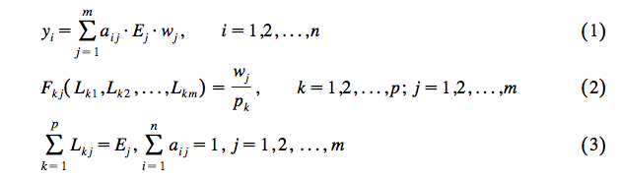
2. Reference framework
In a small open economy
Notes:
A small open economy with n individuals, m factors, and p sectors of production. a(ij): the share of factor j owned by individual i; Ej:total endowment in facto j; Fk: the production function in sector k; Lkj: quantity of factor j used in that sector; wj: the remuneration rate of factor j; pk: the exogenous price of output k.

Slide 6
2. Reference framework
Equation (1) shows income distribution among individuals.
F_{kj} (.) is the marginal product of factor j in sector k. Equation (2) defines the demand functions for various factors of production.
Equation (3) describes the equilibrium of the factor markets at full employment.

Slide 7
2. Reference framework
Combine the above 3 equations, the income distribution of Y can be defined as a function of factor endowments, E_{j}, the exogenous price system p_{k}, and the matrix of factor ownership, A=(a_{ij}):
Y=h(E;p;A) (4)
Assume constant returns to scale, and all countries face same prices, income distribution is a function of “relative endowment variables”: GDP per capita, human capital per worker, presence of mineral resources, concentration of land ownership, etc., as discussed in past studies.

Slide 8
2. Reference framework
However, two important variables are missing from the list: distribution of capital ownership and the relative endowment in arable land.
- Distribution of capital ownership (not a concern): mostly unobservable, income distribution data in developing countries greatly underestimates income from capital.
- Relative endowment in arable land: introduced in this paper to account for the allocation of productive factor between agriculture and the rest of the economy.

Slide 9
2. Reference framework
Due to market imperfection, income distribution is linked to factors in equation (4) as well as to:
(a) exogenous real remuneration of factors exchanged in imperfectly competitive markets
(b) accessibility to this remuneration for the owners of these factors
The introduction of Relative labor productivity (RLP) in agriculture with respect to the rest of economy is to account for market imperfection.
Notes:
(b): such as the rationing scheme
RLP along with relative endowment and factor ownership distribution variable is a proxy for the real product of unskilled workers.

Slide 10
3. Empirical study
Data
A group of 38 small and medium sized developing countries were tested from surveys done around 1970.
Dependent variable
Income distribution data comprises the shares of three income groups (the bottom two and three quintiles, and the top quintile) in total disposable household income.

Slide 11
3. Empirical study
Independent variable
GDP per capita and its square
Secondary school enrolment in 1960 (lagged 10 yrs)
Arable land per capita
Exports of mineral products (dummy variable)
The distribution of land variable
The relative labor productivity variable
Nature of income distribution data
Notes:
Secondary school enrolment: a proxy for the share of skilled workers in the total labor force around 1970.
Exports of mineral products: a dummy variable stands for a country’s endowment in mineral resources (equals to 1 when exports of mineral products accounts for >5% GDP in 1970)
Distribution of land: the share of arable land cultivated by small and medium farmers.
RLP: ratio of the value added per worker in non-agricultural sector to that added in agricultural
Nature of income distribution: total income of active individuals, income per individual, consumption expenditures per individual

Slide 12
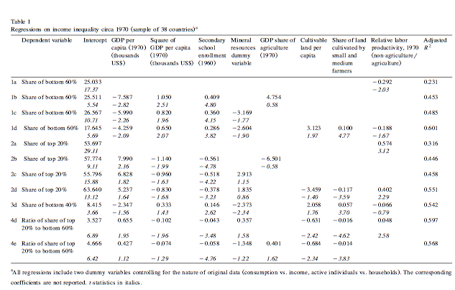
3. Empirical study

Slide 13
3. Empirical study
Regression 1a and 2a
Test the significance of the relative labor productivity in isolation from other variables.
Conclusion: income distribution is partly determined by the dualism in an economy, as represented by the relative labor productivity.
Notes:
Under the assumption that conditionally on relative factor endowment, Relative Labor Productivity (RLP) represents the exogenous labor market imperfection.

Slide 14
3. Empirical study
Regression 1b and 2b
Income inequality depends largely on income per capita (as Kuznets inverted U shaped curve), and negatively on the average level of secondary schooling in the population and negatively on the GDP share of agriculture.

Slide 15
3. Empirical study
Regression 1d and 2d (main novelty)
3 agriculture-related variables are included in regression: Land per capita, share of land cultivated by small and medium farmers, relative productivity differential between agriculture and rest of the economy.
These three variables increase the adjusted R square by 10 to 15 percentage points.
Conclusion: As land per capita increases, as share of land cultivated by small and medium farmers increases, and as the RLP decreases, inequality would decrease.
Notes:
The introduction of agriculture related variables does not change the coefficient of the other variables to a great extent, significance remain the same as well. This is an indication of considerable independence between the two sets of variables.

Slide 16

4. Regression from 1980s sample
More and better data is available at the time of the study.
The 1985 sample data comprises 24 developing countries which appear in the 1970 sample, plus 9 others.
Notes:
The presence of some countries in both the 1970 and the 1985 sample enables us to spot any influence of fixed effects by pooling the two samples.
Yit: dependent income distribution observed in country i at date t. Xit: vector of explanatory variables. Dit: a set of dummy variables taking the unit value for countries observed at 2 dates.

Slide 17
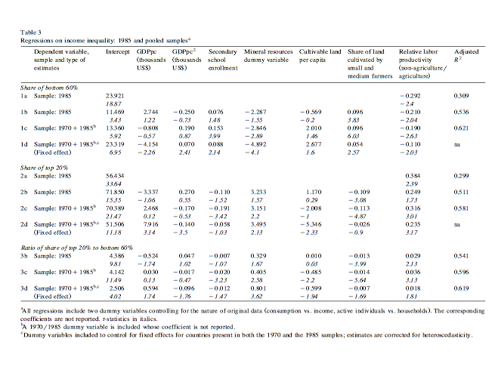
4. Regression from 1980s sample

Slide 18
4. Regression from 1980s sample
Results:
1a and 2a: RLP estimate is very significant, as with the 1970 sample.
1b and 2b: robustness holds only for dualism related variables and the distribution of land. Other variables are less or not significant at all.
1d and 2d (fixed effect): results are similar to those obtained from 1970 sample.

Slide 19
5. Conclusion
This paper contributes to the empirical literature on differences in income distribution across developing countries by putting into evidence the major role played by the extent of economic dualism, as proxied by the ratio of labor productivity in agriculture to that in the rest of the economy, as represented by RLP factor.
The evidence of dualism played an important role is both strong and robust overtime.
These results have important consequences for policy-making in the field of income distribution: increasing the level of productivity in traditional agriculture may have become the most efficient way of reducing inequality and poverty.

Slide 20
6. Comments
Data selection: secondary school enrollment in 1960 was used as a proxy for skilled workers in labor force around 1970. The 10-year lag is relatively short when comparing the mean age of labor force and of children in secondary school. 15 year or 20 year lag is preferred, but data before 1960 was not available, which might render the regression result being biased.
The explanatory power for top 20% and bottom 60% are strong, however, it falls greatly for the bottom 40%, indicating that the very bottom of income distribution may be insensitive to changes in real wage, but reasons behind this phenomenon are not provided.

